Slide 1
Interface (API) Design
Architect’s Perspective

Slide 2
What is an API?
Exposes the public facing functionality of a software component
  Operations, inputs, and outputs
  Waiters & kitchen
Exposes functionality independent of implementation
Internal - used inside of the system / organization
  Limited consumers & full control
  → fast evolution
External – used by clients / partners / world
  Cannot control external entities
  → slow evolution
Proxy for remote call invocation protocols (e.g., Java RMI, SOAP or REST)
  XML, JSON message encoding

Slide 3
Why is API Design Important?
Good vs Bad
  Bad – tempting. No time! Just create a new endpoint!
  Good – think in advance, design & structure everything
Supports QAs e.g.,
  Modifiability – isolate changes behind API
  Interoperability – structured API makes communications simpler
  Security – easier to design a reliable auth scheme & permission boundaries
  Performance – structuring decreases overhead
  Availability – stable contracts enable fault isolation and retries
Good internal APIs improve development processes
  Team independence parallel development (low coupling)
    Otherwise, one team changes something other components are broken
    Integrate by contract

Slide 4
Why is API Design Important?
Public APIs – front door
  Good (structured, logical, clear errors) – keep customers, speed up integrations
  Bad (confusing, fragile, patchy) – "I tried it, never again", error-prone
Public APIs are forever - one chance to get it right
  Contract – thousands / millions are using it
  Cannot force them to migrate
The first version of an API is easy
  Just create endpoints
  Evolving – must support all prior API contracts in use; and maybe BE & DB

Slide 5
Conway’s Law
Programmer Melvin Conway in 1968 …
"Organizations which design systems ... are constrained to produce designs which are copies of the communication structures of these organizations"
e.g. Travel app – same app, two ways to structure the team:
Option A – organize teams by technology:
  Flights team + Hotels team + Payments team
  → Three separate APIs (/flights, /hotels, /payments) – client must stitch them together
Option B – organize teams by customer journey:
  Search team + Booking team
  → Two unified APIs (/search, /booking) – client gets a joined-up experience
Takeaway: your API boundaries will mirror your team boundaries

Slide 6
The Cost of Poor APIs
Longer & costly development
  More time to understand & design
    After the initial stage (esp. for large systems)
  Harder to implement (as harder to understand)
    → increased codebase size & increased complexity & decreased efficiency
    → large attack surface
  More error-prone (as more complex)
  Need more testing
    → more time
Hierarchies of APIs: Application → Framework → Library → Language → System → HW
  Compound effect
  e.g. bad DB driver API → framework adds patches → affects an application → web API
    → defect amplification
  Wrappers – hide bad API, do not fix it
  e.g. C wrapped in C++ wrapped in Python
    → need to understand everything now

Slide 7
Why is API Design Important to an Architect?
API is good? Internals can evolve freely
API is bad? Nothing will help
Architecture – defines how components interact
  API – interaction points & interaction rules
    → Architect’s responsibility & product
  Cannot just give a decomposition diagram to devs
    → Should oversee and dictate API structure, logic, naming, payloads, etc
Well designed modules tend to get reused
  → decrease business expenses overall
  Slack – originally an internal tool that became a commercial product through its API

Slide 8
API Design Qualities
Usability (“DevX”)
  Satisfies requirements (of course)
  Learnability – easy to start using
    Aligns with industry conventions (REST verbs, JSON)
    Consistent patterns (nouns for resources, levels of depth)
    Clear examples in documentation
  Productivity – easy to use, even without documentation
    invoice = client.invoices.create(customer="cust_123", amount=1000)
    invoice = client.exec_action("create_entity", table="invoice", args={...})
    which one?

Slide 9
API Design Qualities
Usability (“DevX”)
  Understandability
    Hard to misuse
    Easy to read and maintain code that uses it
      garageDoor.open();
      system.trigger(12, true);
  Simple, consistent
    POST /users
    GET /users/123
    GET /users?createdAfter=2025-07-12
    DELETE /users/123
    POST /createUser
    GET /system/users?id=123
    POST /user/update?id=123&username=666DarkPunisher666&setting1=off

Slide 10
API Design Qualities
Expressiveness – abstraction matches developer's mental model
  payment.refund(amount=50) – how people think
  payment.createTransaction(type="reverse", value=50) – how it's implemented
  Balance is needed
Extensibility – stable but easy to extend for new versions as necessary
  Versioning
  Optional parameters instead of changing existing ones
    e.g. a new optional field currency with a default value
Performance – speed and resource consumption
  Pagination / batching, caching headers, payload size
Robustness and security – design choices that show up in your API contract
  Security scheme – declare upfront: e.g. API keys, OAuth 2.0, or JWT
  Rate limiting – signal via 429 Too Many Requests + Retry-After header
  Idempotency – PUT/DELETE safe to retry; idempotency keys for POST

Slide 11
The Process of API Design
Prerequisites:
  Requirements
  (partially) identified components
    API ideas can influence decomposition
    Iterative:
      Partially decompose
      Start introducing APIs (spec, prototype, evaluate)
      Realize it's bad (API / decomposition)
      Re-decompose / re-design the API
      … repeat until stable
Requirement drift – requirements change after APIs are published
  Unavoidable API / decomposition redesign
  Minimize the cost: versioning + optional fields absorb most changes
  Breaking changes need a new major version – never silently change a contract

Slide 12
API Design Guidelines
Cohesion – do one thing well
Abstraction – hide the implementation
Information hiding – hide data and operations
Good naming – self-explanatory, consistent, metaphoric
Performance – avoid unnecessary computation & memory allocation
Minimal interface signature surface area – fewer types, functions, parameters; "if in doubt, leave it out"
Good ergonomics – consistent naming, parameter typing and order, error handling; follow platform conventions; establish a guide
Client's perspective – sufficient functionality, testability
Support Usage (use case) policy (degree of coupling) – policy-free (general) vs policy-rich (special purpose)
Document – involve users, cover edge cases, unit tests; avoid developer bias

Slide 13
Evaluating APIs — The HCI Parallel
Traditional interface testing:
  Can a user complete a task efficiently, effectively, and without confusion?
API evaluation:
  Can a dev achieve a goal using this API without frustration, errors, or workarounds?
Experts using heuristics
  “Users” do cognitive walkthroughs
  “User” testing – programmers are given tasks to complete using the API — like a usability test, but the users are devs

Slide 14
API Heuristic Evaluation
Visibility of status – check system state
Match to real world – meaningful naming
User control and freedom – abort or reset operations
Consistency – e.g. parameter order
Error prevention – e.g. default parameters do the right thing
Recognition over recall – naming again – familiar names reduce memory load
Flexibility and efficiency – programmability
Aesthetic and minimalist design – good naming
Error recognition and recovery – helpful error returns/exceptions
Help and documentation – available and accurate

Slide 15
API Contracts
"Classes of a system communicate with one another on the basis of precisely defined benefits and obligations" [Bertrand Meyer, CACM, Vol 36, No 9, 1993]
Expectation – contracts are correct
  If conditions from both sides are met, the result will be as defined.
  Client must satisfy pre-conditions; Supplier guarantees the result
Correctness / conditions
  Pre-condition – always True before an interface is invoked
    Client's responsibility
    e.g. def withdraw(account, amount)
      requires: amount > 0 and amount <= balance
      If amount > balance, fail
      Not supplier's fault
    Protects a supplier from responsibility

Slide 16
API Contracts
Correctness / conditions (continued)
  Post-condition – always True after interface completed the work
    Supplier’s responsibility
    e.g. balance_after = balance_before – amount
      If not true, the supplier broke the contract (e.g. race condition)
    Ensures trust & predictability
  Invariant – always true
    e.g. account.balance >= 0
      If violated, something is completely wrong
    Preserves system integrity
Violations
  Precondition – not our problem
  Postcondition – our problem
  Invariant – total disaster
“The API Performance Contract”, Sproull, Waldo, CACM, 3/14

Slide 17
API Contracts
Performance – contract
  Fast – approaches constant time
  Usually fast – e.g. <200ms for 95% of requests
  Variable but predictable – depends on the size / complexity, but stable dependency
  Variable & unpredictable – external dependency, no guarantees
Why do contracts matter?
  Isolation of responsibilities
    Each component’s responsibility & correctness are independent
  Predictable integrations
    Distribute responsibilities across components → each can be designed and implemented independently
  Verification & testing
    Know what to test for each component
“The API Performance Contract”, Sproull, Waldo, CACM, 3/14

Slide 18
Documenting Interfaces: Interface Specification Template
Interface identity
  Name – unique
  Version – traceable breaking changes
Responsibilities
  Services / functions / endpoints provided (*IDL option)
  Signature syntax (arguments, types, etc.)
  Semantics – usage scenarios
    Pre/post conditions, return values
    Cross function coordination / dependencies
    Usage restrictions (initialization, timing of use, ownership, etc.)
Data type definitions – application specific
Exception definitions and handling
*IDL – Interface Description Language – self descriptive, language independent, human and machine readable

Slide 19
Documenting Interfaces: Interface
Specification Template
Variability – what can alter the interface behavior
  Configuration
  Parameters (e.g. async=true, timeout=59, batchSize=200)
Quality attributes of the interface, e.g.
  Performance guarantees
  Reliability
  Scalability
Resource requirements
  Resources required (hardware)
  Dependencies (e.g. DB)
  Permissions / credentials
Rationale – the structure of an Architecture Decision Record (ADR)
  Alternatives
  Criteria
  Choice reasoning
  Trade-offs

Slide 20
Specification Example
Interface Identity | userCreate
Responsibility | userCreate(firstName, lastName, type, email, password) {...} returns: id
Data Type Definitions | String firstName; String lastName; String type; // default = “member”, other = “leader”, “admin” String email; String password; int id = uniqid(); // a unique identification number
Exception Definitions and Handling | UserAlreadyExistsException - thrown when the system attempts to create a user that already has the specified firstName & lastName or email. When thrown, the user is redirected to the Create User page. UserNotAuthorizedException - thrown when an unauthorized user tries to create a new user. When thrown, the user is redirected to the Create User page and an administrator is notified of this action.

Slide 21
Specification Example
Interface Identity | Shopping Cart
Responsibility | Add Item to cart ● URL ○ /account/addItemToCart ● POST ○ Input ■ Item: JSON ItemObject ○ Output ■ The server adds the item to the user’s cart ■ A status message and code is returned back
Data Type Definitions | In JSON format: Name - Name of the object Rating - Rating of the object Description - Description of the object Array of {Vendor, Price, Link} objects
Exceptions | Returns JSON with an error code and message describing the issue

Slide 22
Documenting APIs in Practice
On paper – structured spec (see slides 18–21)
  Interface identity, responsibilities, data types, exceptions
  Rationale, variability, quality attributes, resources
In practice – OpenAPI / Swagger (formal standard, OpenAPI Initiative)
  Machine-readable YAML/JSON: endpoints, types, and errors in one file
  Generates documentation, client SDKs, and test stubs automatically
  Live demo: https://petstore3.swagger.io/

Slide 23
440 Hackathon
So, APIs are a ‘must’ for SW Engineering … let’s try them out
GitHub - public-api-lists/public-api-lists: A collective list of free APIs for use in software and web development 🚀
Pick a public API (w/o auth)
How fast can you implement it?
  15 minutes: Starts … now
  Demo to the class

Slide 24
Commercial APIs: Assignment
https://mycourses.rit.edu/d2l/le/content/983442/viewContent/8304550/View
Pick one of the following APIs :
  Web App – Mailchimp: http://developer.mailchimp.com/documentation/mailchimp/reference/overview/
  Drone control - DroneKit-Python API Reference (dronekit-python.readthedocs.io)
  Gitlab - https://docs.gitlab.com/ee/api/api_resources.html
  Crypto++: Crypto++ Library 8.6 API Reference (cryptopp.com)
Browse to form learnability first impressions
Evaluate the details of a few specific APIs from a developer's perspective
  Understandable?
  Simple to use?
  Limitations or other concerns?
  Cohesion/coupling?
Notes:
Alternatives?
Stripe - https://docs.stripe.com/api
NASA - https://api.nasa.gov/

Slide 25
Appendix
Facts and references

Slide 26
What is in use today?
Google: 5+ trillion API calls/year (2025)*
Facebook: billions API calls/second (2014)*
Amazon: 151 million DB calls/second (2025, Prime Day)*
Twitter: 3 billion API calls/day (2010)*
Netflix: 20 billion API calls/month (January 2011)**
eBay: 9 billion API calls/month (November 2009)***
Bing: 3 billion API calls/month (March 2009)*
NPR: 1.1 billion API-delivered stories/month (March 2010)*

Slide 27
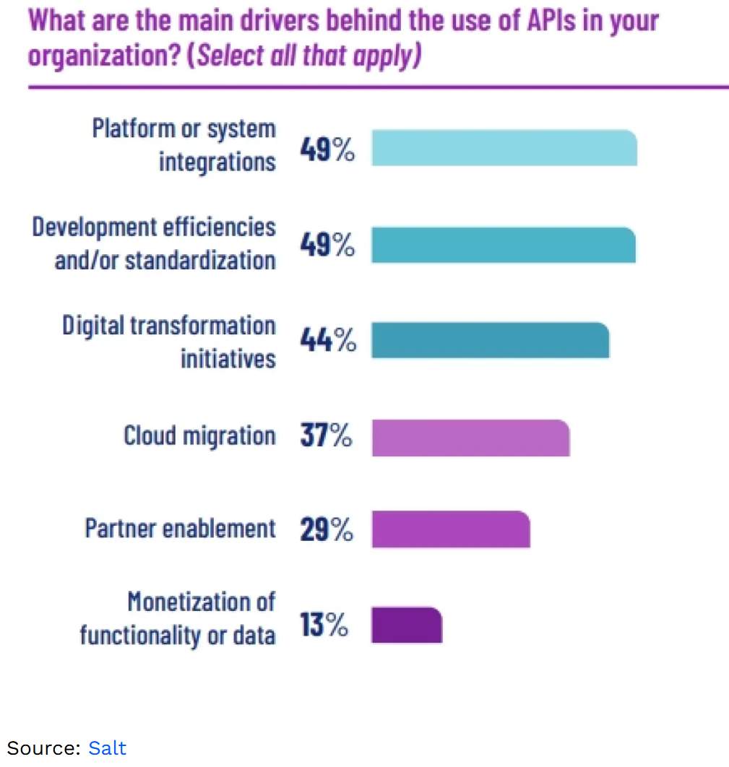
General API statistics
The fastest-growing type of data in 2021 was API data which grew by more than 20%. ( Cloudflare)
POST method is the most common method used in APIs, with more than 50%, followed by GET method, with almost 45%. (Cloudflare)
The market capitalization of companies that have adopted APIs has grown by more than 12% compared to those that have not adopted APIs. (Forbes)

Slide 28
Just the facts …
Over 90% Of Developers Use APIs
Developers Spend 30% of Their Time Coding APIs
This is almost double the second most time-consuming task, manually debugging code, which clocks in at 17%.
Travel Data Is a Top Integration Need
Open Banking to Have 130 Million Users by 2024
Healthcare APIs Are Growing By 6.3% CAGR
83% of All Internet Traffic Belongs to API-Based Services
93.4% of API Developers Are Still Using REST

Slide 29
More facts …
API statistics in industries
Finance
More than 1 billion API calls were made in May 2022 to open banking APIs. (Open Banking)
The number of API calls made by the financial sector experienced a 125% growth in 2020. (Google Cloud)
The number of APIs deployed in the banking sector is anticipated to increase by 100% from 2022 to 2027. (McKinsey)
48% of FinTech companies indicate API security as a top concern in API utilization. (FinTech Future)
Retail
The retail and travel industry had the most API calls made in 2020, with 34%. (Google Cloud)
More than 50% of retailers have indicated that APIs accelerate innovation, and 36% indicated that APIs are a strategic asset that can create business value. (Google Cloud)

Slide 30
References
“How to Design a Good API and Why it Matters”, Joshua Bloch, Google
“API Design Matters” Michi Henning, CACM May 2009
“Practical API Design: Confessions of a Java Framework Architect”, Jaroslav Tulach, Books 24x7
“Improving API Usability”, Myers Stylos, CACM May 2016

